Slide 1




Slide 2

AMERICAN JETSTREAM PRE-INTERMEDIATE B

Slide 3
TEACHER’S PERSONAL INFORMATION
Name: Nguyen Thanh Loan
Facebook: Loan Nguyễn Thanh
Mobile number: 0942 255 937
Email: loannguyenthanh1978@gmail.com

Slide 4



UNIT 10
The news and journalism

Slide 5

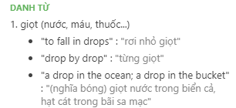
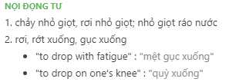
Verbs of movement
to drop /drɒp/

Slide 6
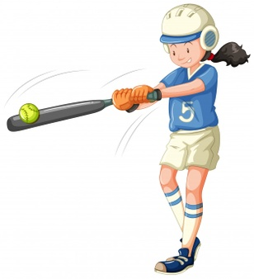
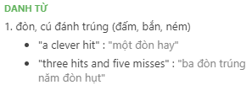
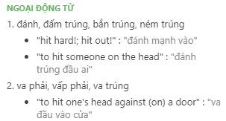
Verbs of movement
to hit /hɪt/

Slide 7

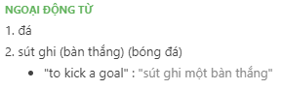
Verbs of movement
to kick /kɪk/
Ex: He was accused of kicking a man in the face.

Slide 8
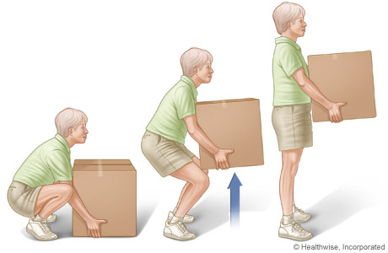
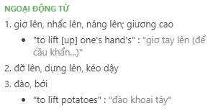
Verbs of movement
to lift /lɪft/
Ex: Could you help me lift this table, please?

Slide 9
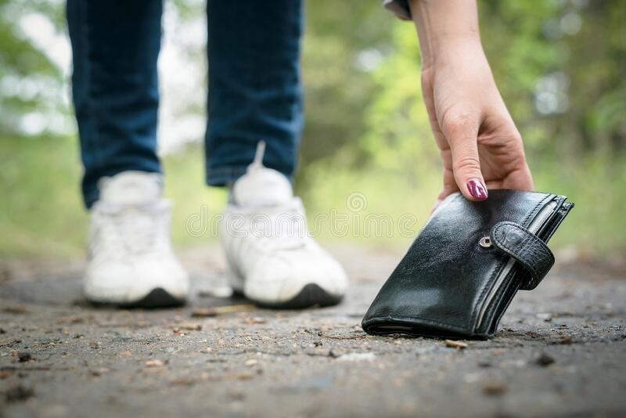
Verbs of movement
to pick up
Ex: A truck picks up the recycling once a week.

Slide 10

Verbs of movement
to lie down
to move into a position in which your body is flat, usually in order to sleep or rest:
Ex: Why don't you lie down on the sofa for a while?

Slide 11


Verbs of movement
to get up
Ex: The whole audience got up and started clapping.

Slide 12
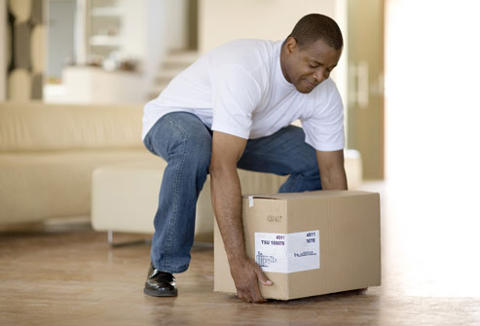
Verbs of movement
to put down
/ˈpʊt.daʊn/

Slide 13


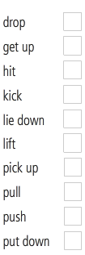

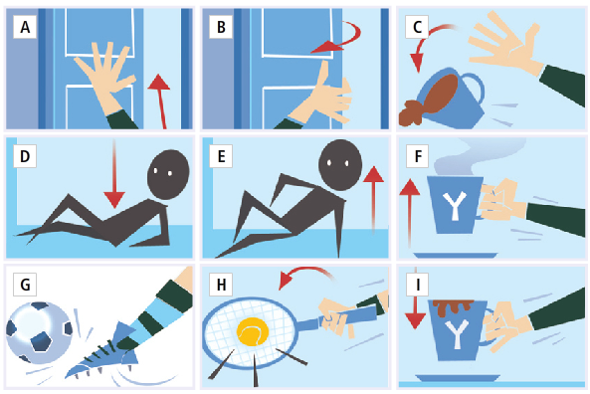
VOCABULARY PLUS
Verbs of movement

Slide 14
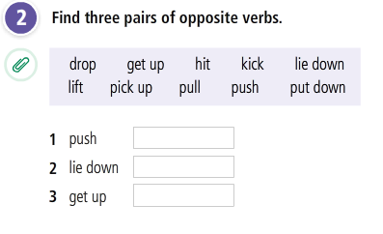
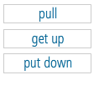
Verbs of movement

Slide 15
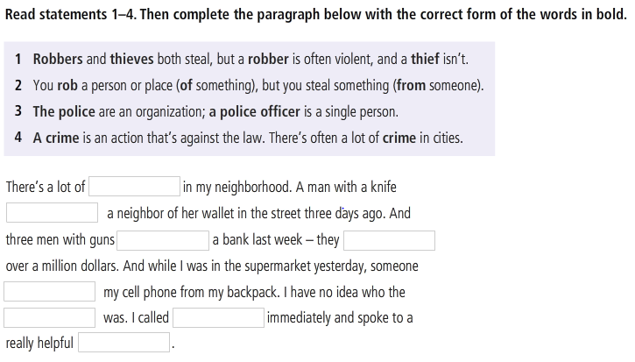
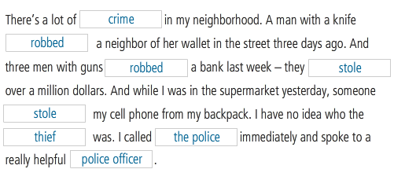
Crime

Slide 16
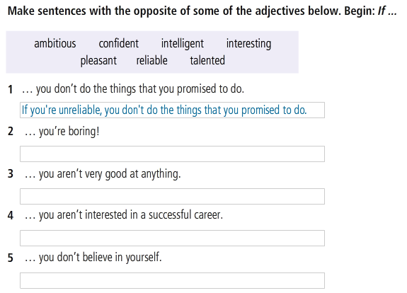
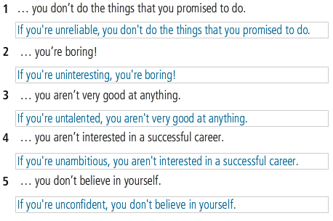
Worldbuilder
Prefix: UN

Slide 17
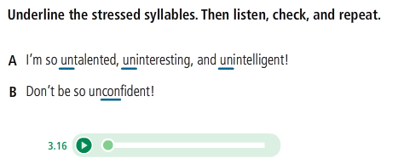
Worldbuilder
Prefix: UN

Slide 18
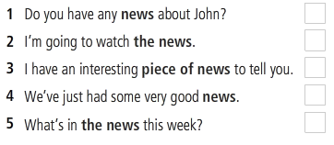
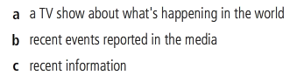
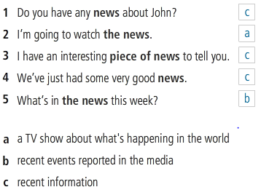
Focus on:
The news

Slide 19
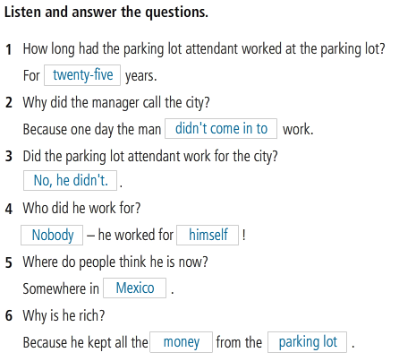
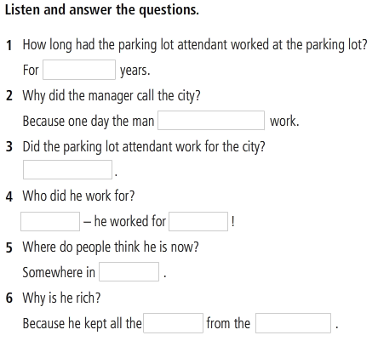
LANGUAGE IN ACTION
Telling an anecdote

Slide 20
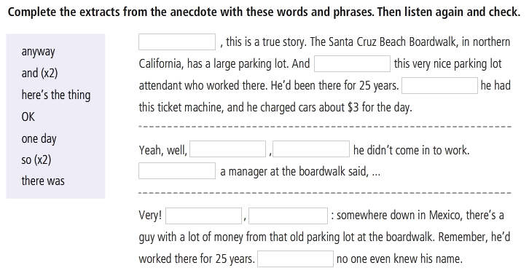
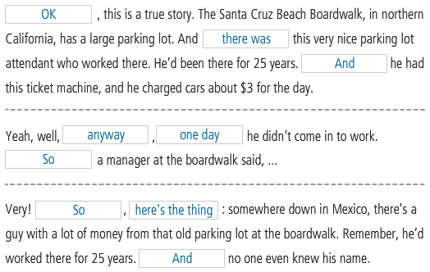
Telling an anecdote

Slide 21
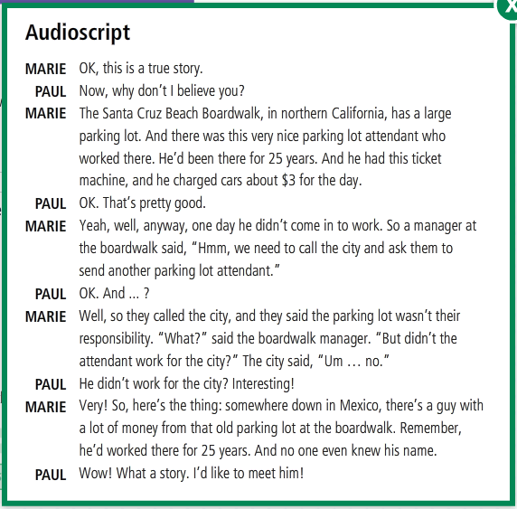

Slide 22
REFERENCES
Listening: News item
https://www.youtube.com/watch?v=TCdaQjcN7x8
Reading: News item
https://www.youtube.com/watch?v=5_Dcaepr3d8

